Slide 1
SOFTWARE ENGG. PROJECT
STUDENT COURSE MANAGEMENT APP

Slide 2
INTRODUCTION :
Student Course Management systems refer to virtual learning environments that are categorized based on pedagogical tools such as content creation, communication, administration and assessment.
In this i have used react to make this app.
Course Management Systems (CMS) are software packages that bring together numerous Internet tools and allow them to be accessed via a simple and convenient user interface.

Slide 3
AIM of the PROJECT
A typical CMS will provide such tools as:
user registration and authentication, creation of static web pages, file exchange, tests and surveys, student grading, journals, wikis, photo galleries, chat rooms,etc.

Slide 4
SCOPE AND PURPOSE :
Can be used in university and faculty and schools in
course, to access , to link e-learning ,to show course , to upload lectures and to save the lectures .

Slide 5



Tools Used
React Native
Firebase
Android Studio

Slide 6
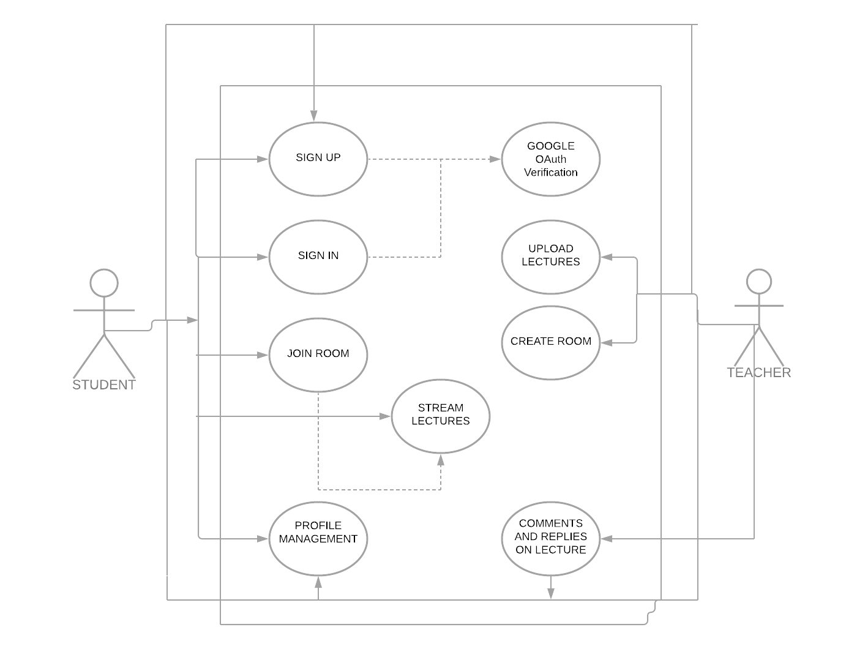
USE CASE DIAGRAM

Slide 7
APP LAYOUT / USER INTERFACE (UI)

Slide 8
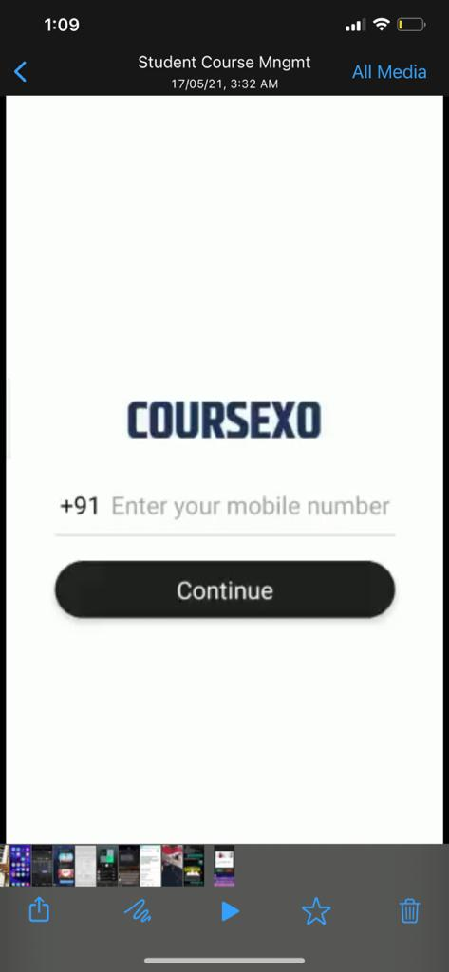
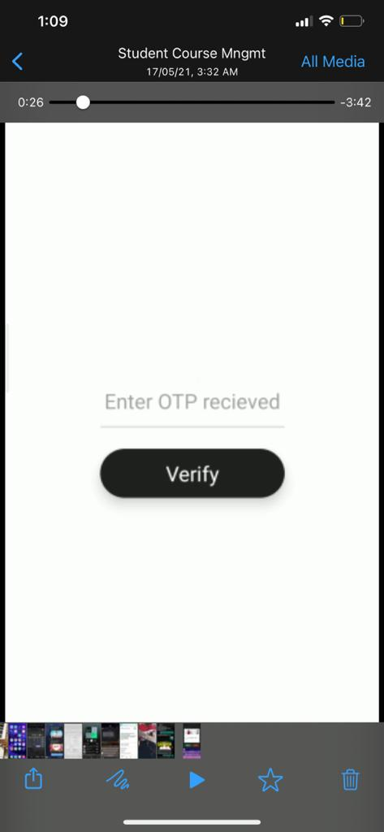
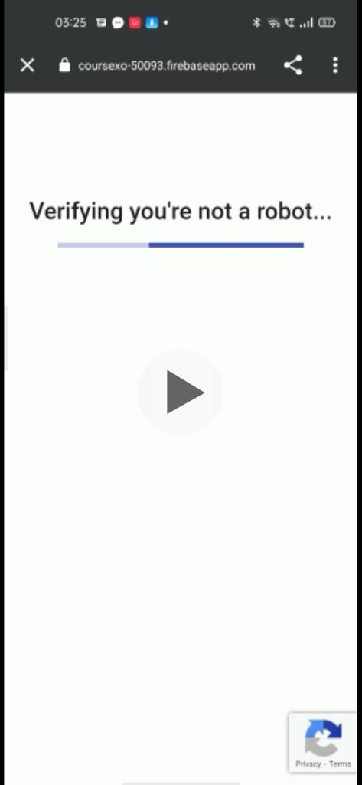
LOGIN SCREEN OTP VERIFICATION Google O’Auth Verification

Slide 9
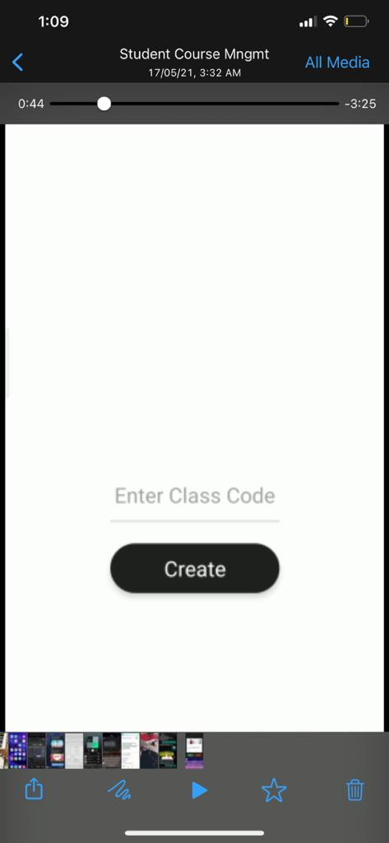
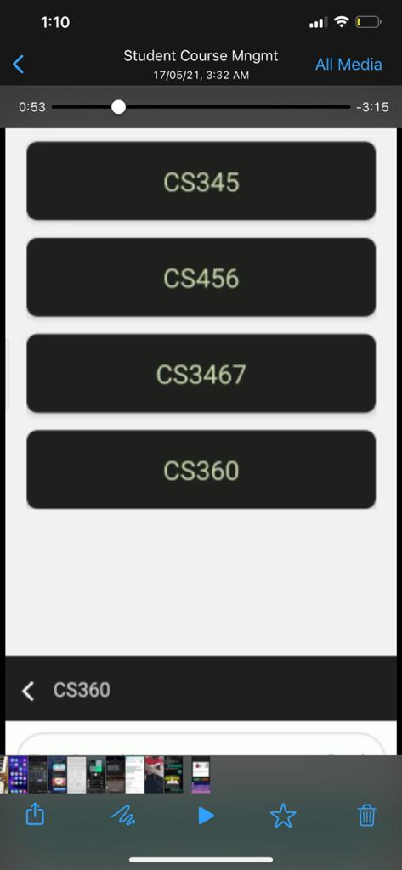
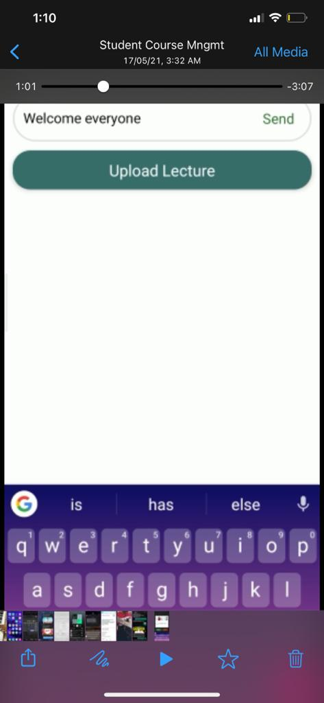
ADD new Course Enter The Course Teachers Access Course

Slide 10
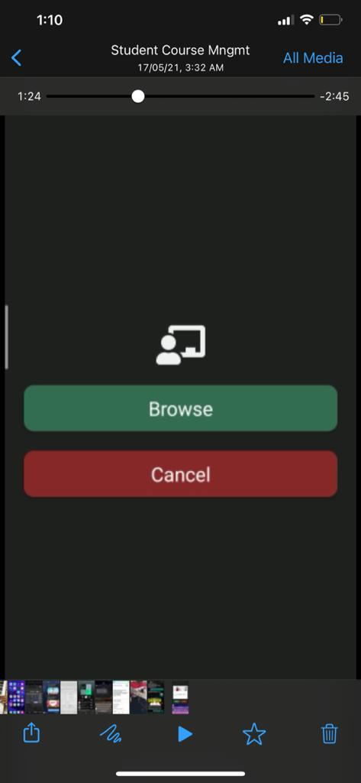
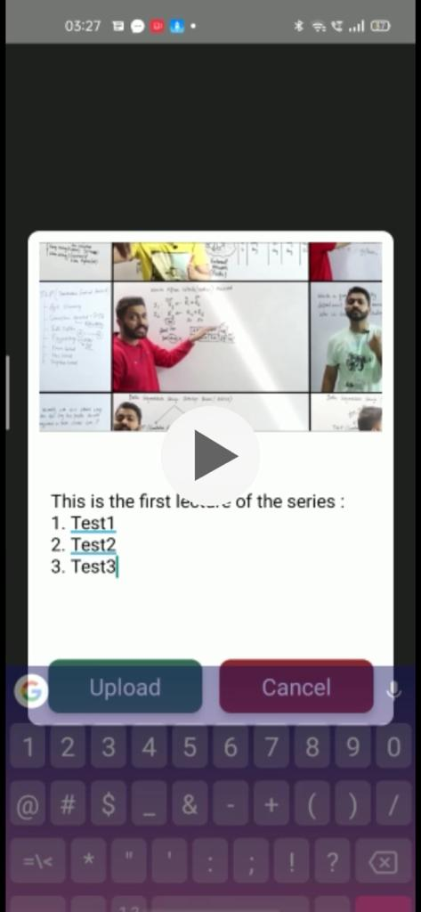
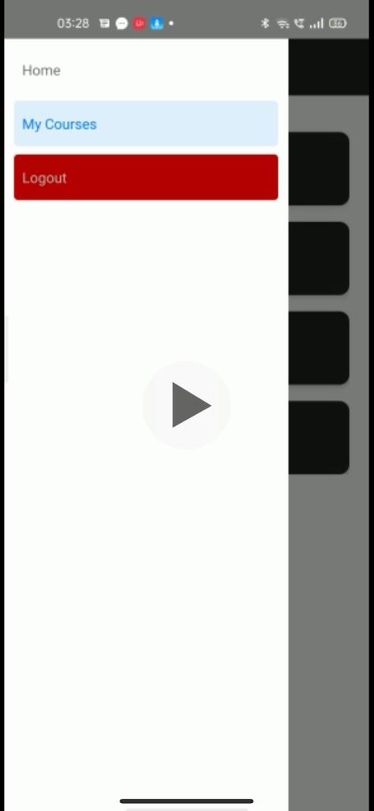
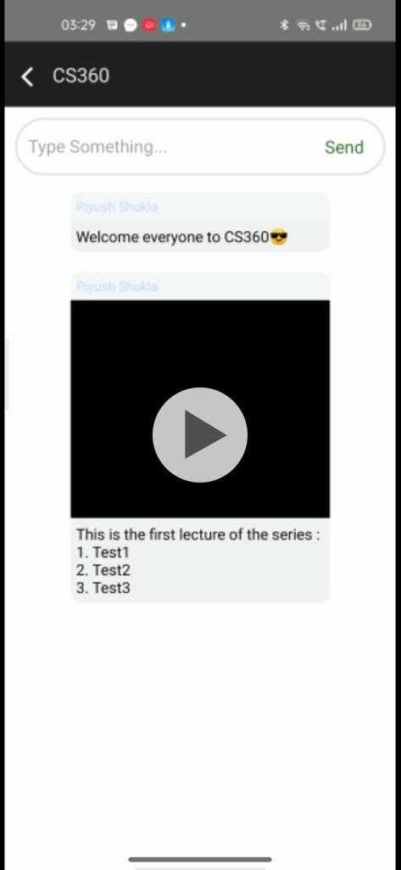
Students Can Login and Access Lectures
Upload Lecture
Upload link/comment,etc
View Courses/ Logout

Slide 11
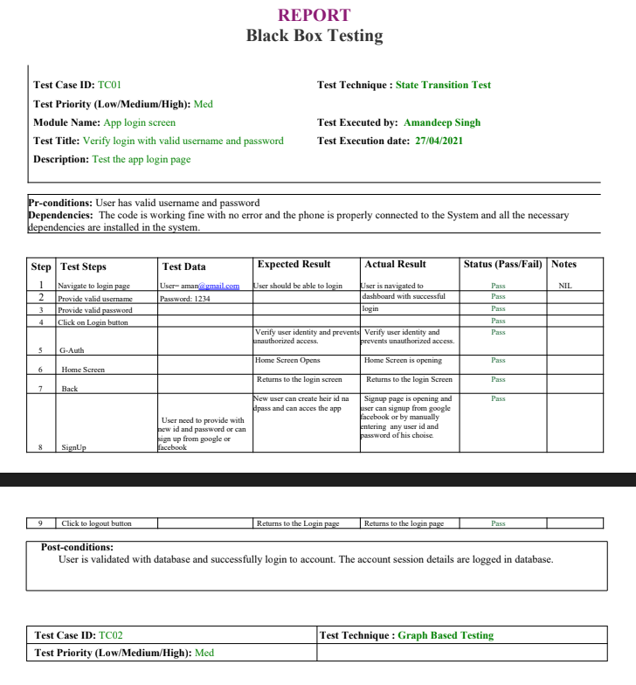

Slide 12
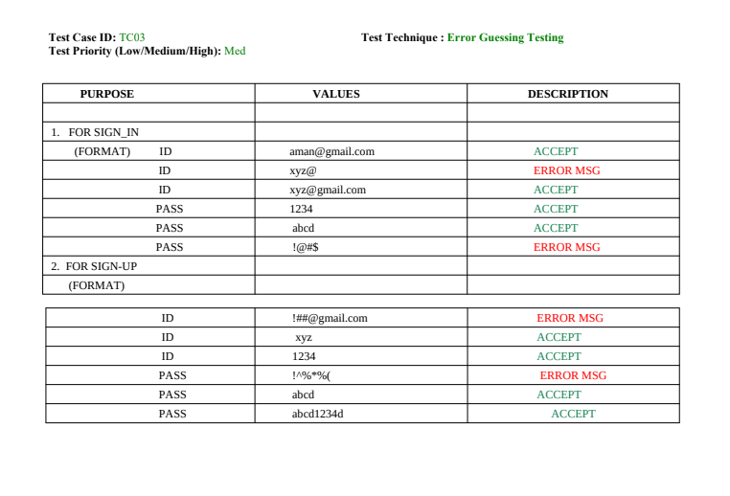

Slide 13
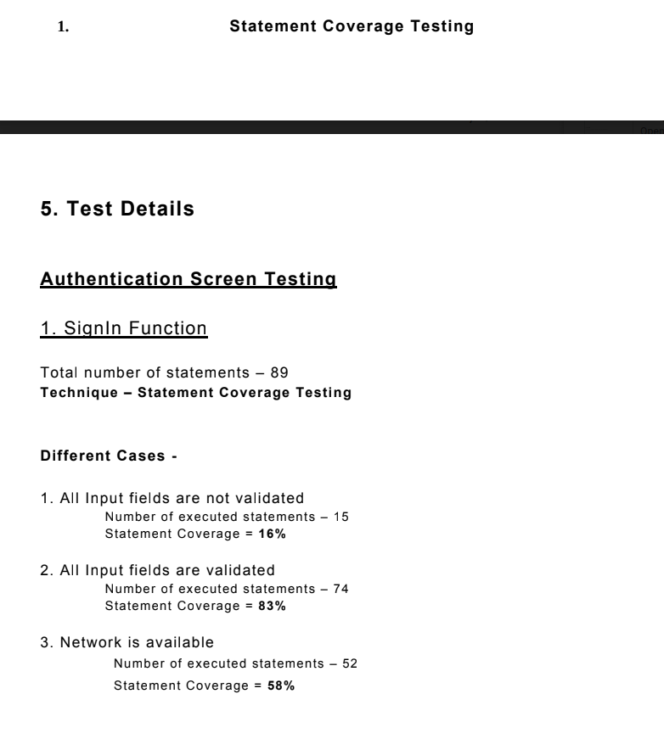
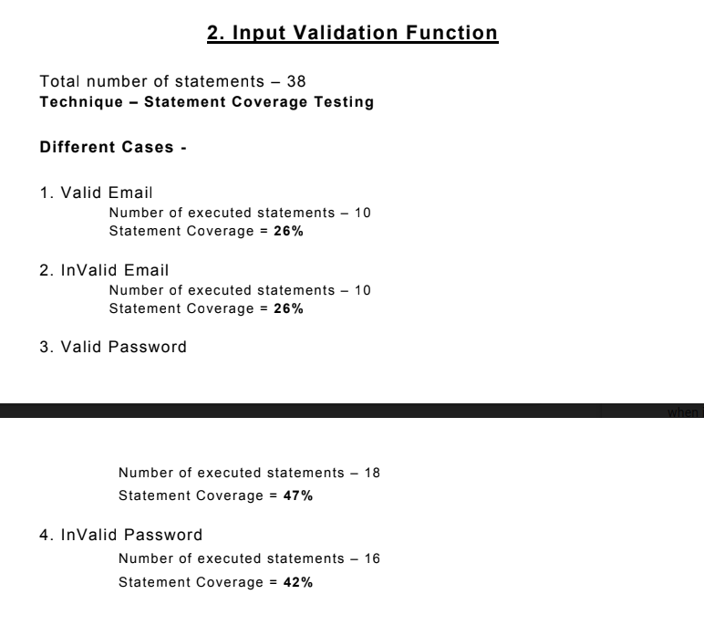
WHITE BOX TESTING

Slide 14
Thank You
Amandeep Singh
(18010129)

